Slide 1
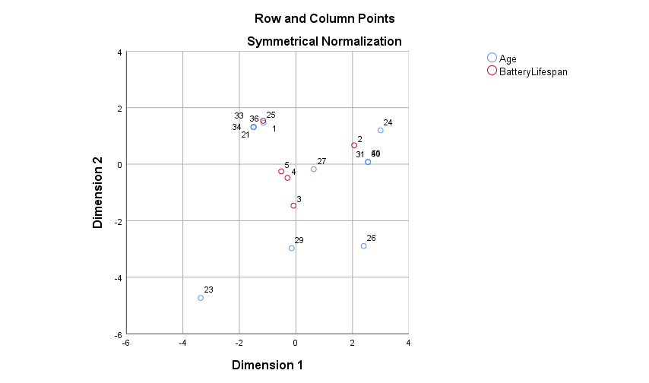
Age and Life-span

Slide 2
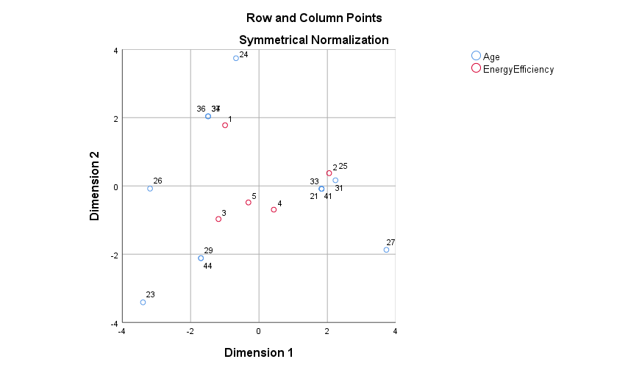
Age and Energy Efficiency

Slide 3
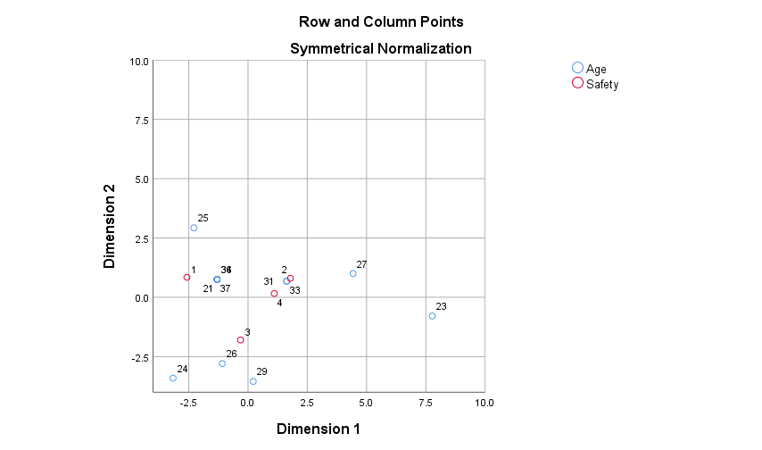
Age and Safety

Slide 4
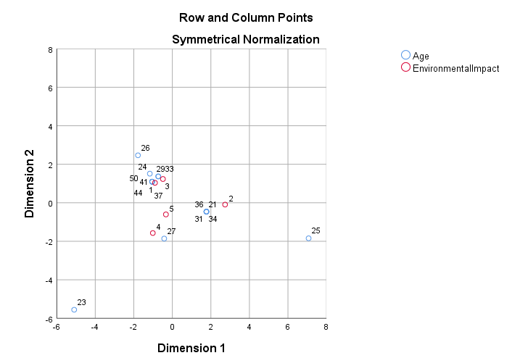

Age and Environment Impact

